Slide 1
LOCKDOWN BUT LOGGED IN

Slide 2
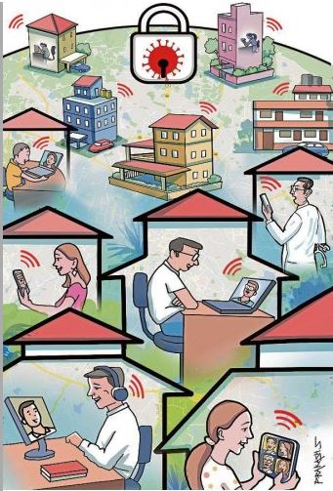
Lockdown but log in Forced out of the roads, locked in to beat a virus spiraling out of control, Bengalureans have had to stay put inside their homes for two weeks now.
Beyond those working from home, a huge mass of people are in dire need of a distraction from extreme In comes, technology! technology has damatically altered the otherwise mundane indoor space for millions in the city. From ‘Fam Jams’ through online video platforms such as Zoom, Hangouts, Skype and Duo to multi-player video games, tele-medical consultations to the smartphone's unlimited array of killer apps, tech is everyone’s obsession.
Zoom, Duo, Hangouts Google Hangouts and Duo are other preferred
options. But Zoom’s ease of use is now challenging
the once dominant Skype platform. To be seen and
engaging face-to-face is what makes the interface
so attractive, say users.’

Slide 3
Connected devices
Smart devices in a connected word are making a big difference even in the in-house communication space. Many use the smartphone to access the video-chat apps, but the prevalence of Smart TVs in many homes expands the space. The video chats are often streamed / mirrored onto the big TV screen where multiple windows with friends and family within the city and abroad open up.
Beyond family and friends, the video platform has also helped students of multiple hobby and self-defense classes to brush up their skills. As Anuplal Gopalan, a professor of Sociology informs, his son’s Karate master remotely shows the moves so that the steps are not forgotten. Dance classes too have gone online this way. Stuck indoors with no chance to go out and play, teenagers across the city have gone back to what they do best: Video games, both online and offline. PUBG is an old favourite, but online battle but games such as Fortnite : Battle Royale and Call of Duty: Warzone, are all back in vogue, big time. For theatre artistes, standup and other visual art performers, the lockdown has meant a total redefinition of their connections with the audience. Since social distancing is the mantra to combat the deadly Covid-19, they have all dived deep into the social media space.
Social media
They are modifying their art, and tweaking the content to maximize the power of social media. For instance, city-based playback theatre artiste and trainer, Ranji David has reworked the format to present a solo show on Instagram straight from his home in Thippasandra.

Slide 4
An intimate theatre form, Playback Theatre sources content from the audience and the artistes come alive with the stories spontaneously. There are no rehearsals, but the craft employs a set of body movements and communication tools to dramatise the stories. For David, Instagram was the medium to source stories online.
Tech and charity
The lockdown has severely constrained the movement of many who are eager to go out and help daily wagers and others now in dire need of food and other essentials. Bengaluru-based educationist A Senthil Kumaran has come up with a unique strategy that mixes technology, networking and charity.
As Kumaran points out, schools have shut down across the country and employed multiple strategies to just port what they were doing in a classroom into an online environment by adapting existing/new technology tools.
He says it is critical now to empower School Leadership Teams with strategies to manage place, people and practices in their respective campuses and develop an action plan to leverage the post-pandemic situation.
Kumaran has offered a virtual session through Zoom on April 8 to 50 participants. The cost of each session, Rs 2,000, he adds, will be contributed directly by participants to the PM CARES Fund.

Slide 5
Digital payments
In recent years, online bill payment for various utilities has emerged as a viable alternative to long queues. But there were still a big mass of people who preferred the physical route. The lockdown has reduced the options to only online.
However, this surge in digital payments is likely to be a temporary phenomenon, feels Srinivas Alavilli from Citizens for Bengaluru (CfB). “There has been a steady increase in digital payments ever since DeMo but as numbers show, people still largely deal with cash.
But the tech-switch has become inevitable during the lockdown. “Utilities such as water supply board and electricity stand to gain if first-time users find online payments more convenient and stick to them as their costs will come down and give them better cash flow,” Alavilli adds.
Online crowdfunding
Technology helped make another transition: Online crowdfunding. “The migrant labour movement across the country moved a lot of people to tears and inspired them to support relief efforts. My sense is lakhs of Indians discovered online crowdfunding platforms for the first time. This bodes well for that future as it opens up an entirely new world of charity and funding for micro enterprises and causes.”

Slide 6
Project Home Theatre
Film actor and theatre person P D Sathish Chandra has launched another unique experiment using technology to collate video content. Home is his base, but tech has allowed him to reach out to collaborate with a much wider network .
“Based on Couch Potato, I have asked 51 actors, cinema stars, writers both young and old and students to read out from Kannada writer Jogi’s book ‘Life is Beautiful.’ I have so far compiled 46 videos of their readings, which will be made into a videobook and uploaded on YouTube.”
As illustrated by the likes of David and Chandra, the lockdown period has seen a mix of both content production and consumption across multiple platforms. Collaboration, critical to many of these endeavours, is being achieved through smart use of technology.

Slide 7
THANK YOU

